Slide 1




Analysis of hydrothermal alteration of the Flynn Creek impact crater
Haley Leonard
Mentored by Tenielle Gaither
USGS Astrogeology Science Center

Slide 2
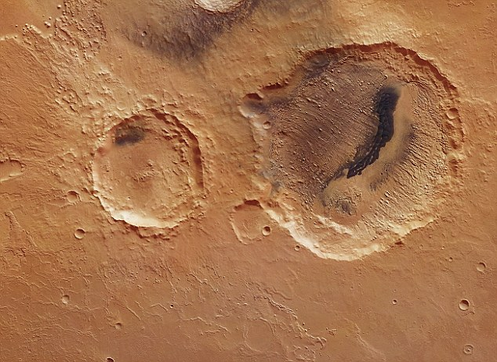
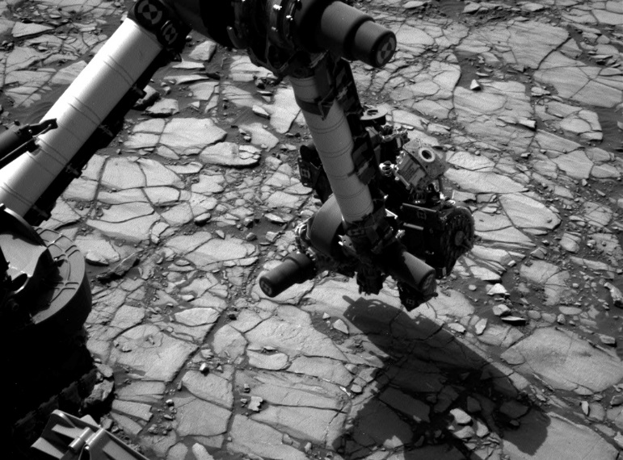
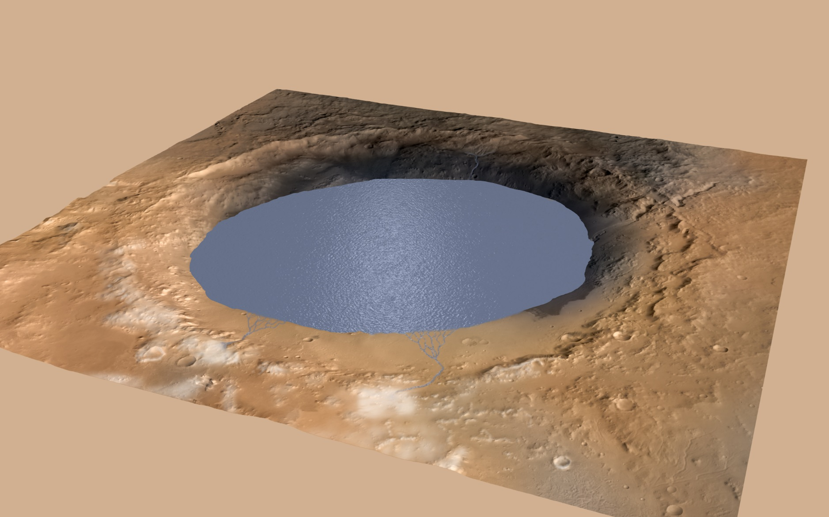
Why study terrestrial impact craters?
Analogues for impact cratering processes on other planetary bodies
Analogues for habitable environments on early wet Mars
(a) Impact crater X on Mars
(b) Curiosity rover examining target Marimba, within Gale crater, Mars
(c) Artist’s sketch of lake-filled Gale crater, Mars
Notes:
First off, I would like to talk to you about why studying impact craters is important. Or in other words, why do we care?
First, the study of impact craters on Earth is important because it helps us make inferences about impact cratering processes on other terrestrial bodies. (Define analogue)
Second, craters on Earth that had impact generated hydrothermal systems are analogues for potential habitable environments on early wet Mars.
So, what is a “habitable environment”? One of the most important questions in planetary science is, Could life as we know it have evolved on another planet? Since life as we know it requires liquid water, NASA is investigating this important question by exploring environments on Mars that show geologic evidence for having liquid surface water in the distant past. The Curiosity rover is examining rock units that contain minerals that could ONLY have formed by precipitation from liquid water.

Slide 3
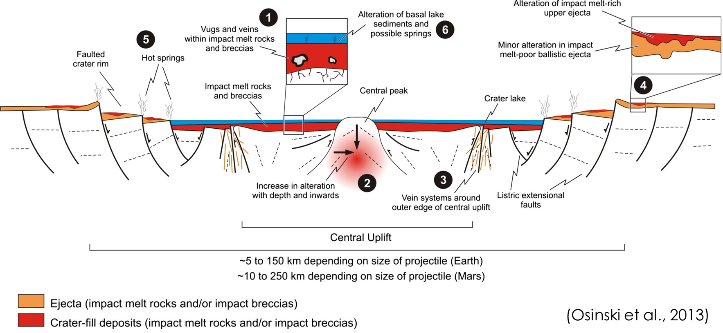
Impact-induced hydrothermal systems
Notes:
Overview of figure: crater rim, moat, central uplift, lake
When an impact crater is formed, the residual heat within the target rocks from the energy of the meteorite impact provides a mechanism for water to remain liquid – at a temperature compatible with life. This is why ancient hydrothermal systems are of interest to planetary scientists – they may have been warm, wet oases suitable for life.
Flynn Creek crater is a perfect terrestrial analogue for Martian impact-induced hydrothermal systems.
This image shows a cross section of a complex crater with an impact induced hydrothermal system.

Slide 4
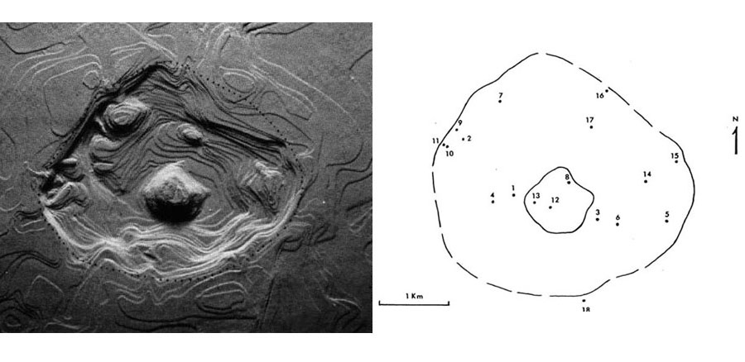
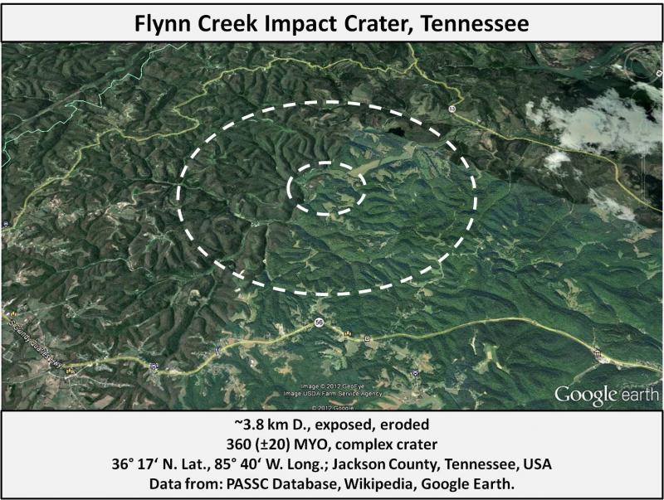
Flynn Creek impact crater
A
B
C
Figure A. Reconstruction of the Flynn Creek Crater by David Roddy (1977b)
Figure B. Locations of the 18 drill holes
Figure C. Google Earth image of present-day exposure of Flynn Creek crater
Notes:
The Flynn Creek crater is a flat-floored, complex marine impact crater approximately 200 meters deep and 3.8 kilometers in diameter. It formed 360-million years ago in what is now north central Tennessee. The impact occurred into carbonate target rocks within a shallow sea. This marine setting, coupled with residual heat from the impact, generated a hydrothermal system within the crater for hundreds to thousands of years after the impact.
The first image is a google earth image of what Flynn Creek looks like currently (doesn’t really look like a crater): immediate deposition of Chattanooga shale, subsequent deformation and erosion produced the current morphology of the crater.
In the 1960’s and 70’s, Dr. David Roddy of the USGS Astrogeology directed a drilling campaign at Flynn Creek, which produced over 2200 boxes of drill core, from a total of 18 drill cores.
Figure B is a map of the locations of the drill cores. The central uplift of the crater is the inner circle. My research used samples from these drill cores.

Slide 5
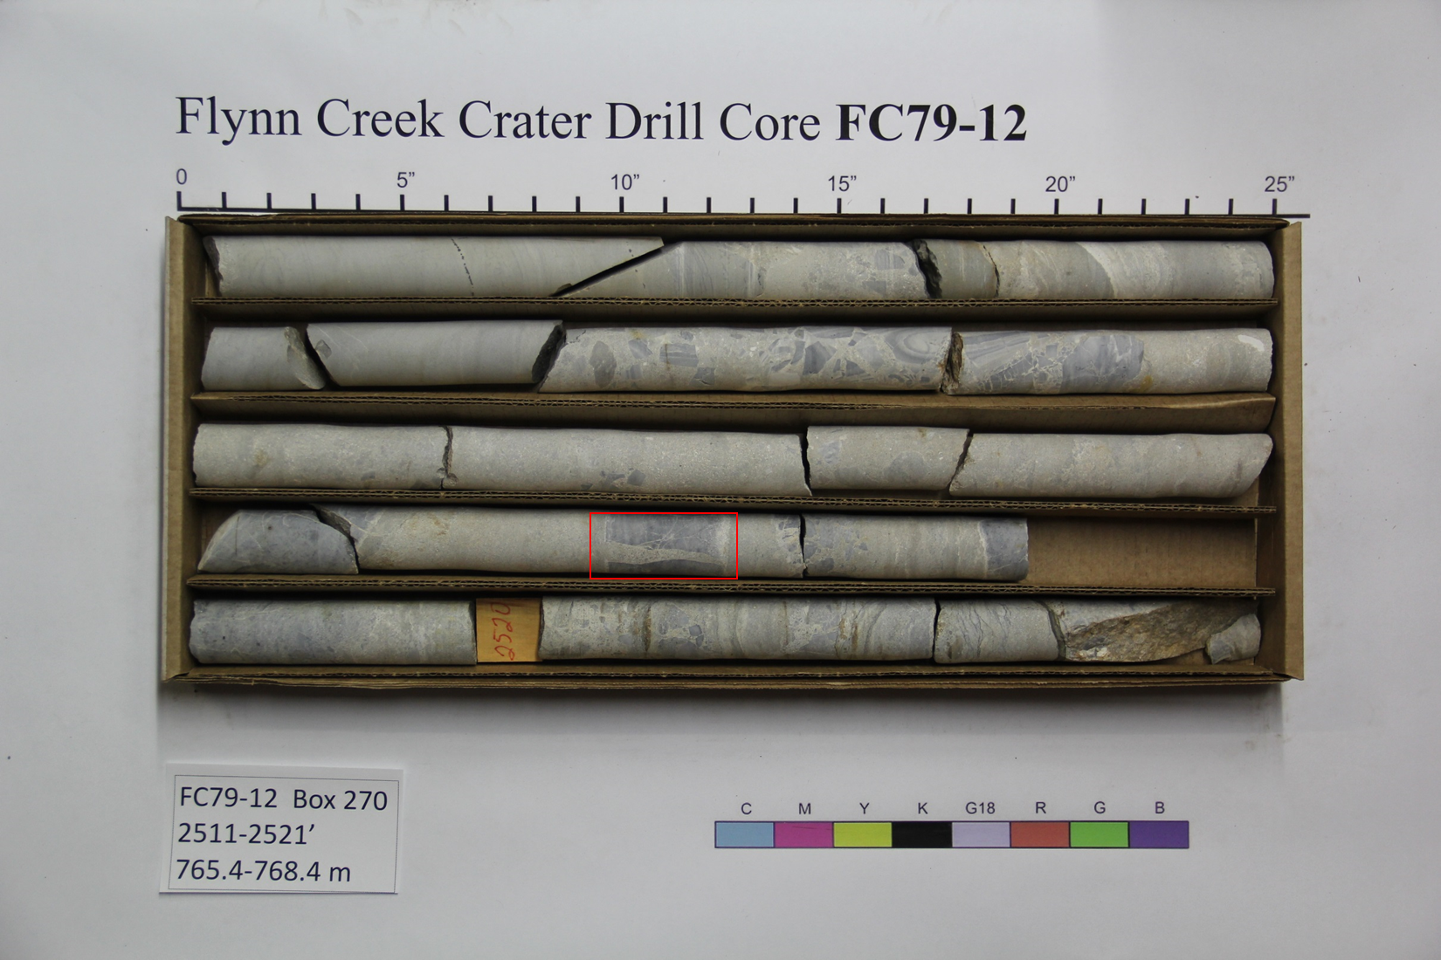
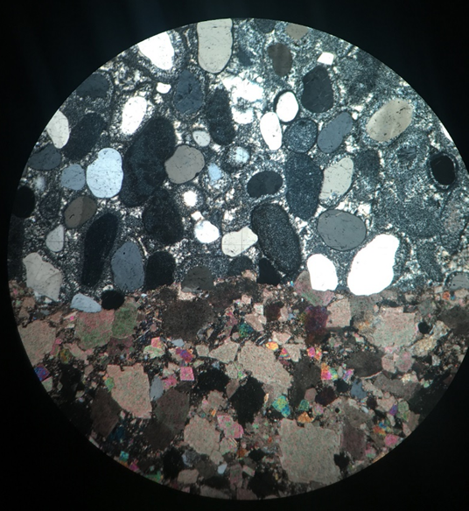
Research methods and goals
Photograph drill core boxes and select samples to be made into thin sections
Use petrographic and microbeam analysis to determine mineral assemblage, and then estimate temperatures at which minerals crystallized
Use mineral crystallization temperatures to characterize the temperature range of the impact generated hydrothermal system
Notes:
We’ll work on text for this later.
You don’t need to say anything about how the photography was done via student contract – just lump it all together for brevity.

Slide 6
Target rock lithologies
Dolomite
Limestone
Shale
Chert
Notes:
Hydrothermal systems alter the original parent rock mineral assemblage via metasomatism – circulating water dissolves minerals, and precipitates specific minerals depending on the temperature and pressure of the system etc etc. The resulting mineral assemblage is therefore dependent upon the original rock types.
Here we have a stratigraphic column from Flynn Creek crater which shows the target rock type. Limestone Dolomite

Slide 7
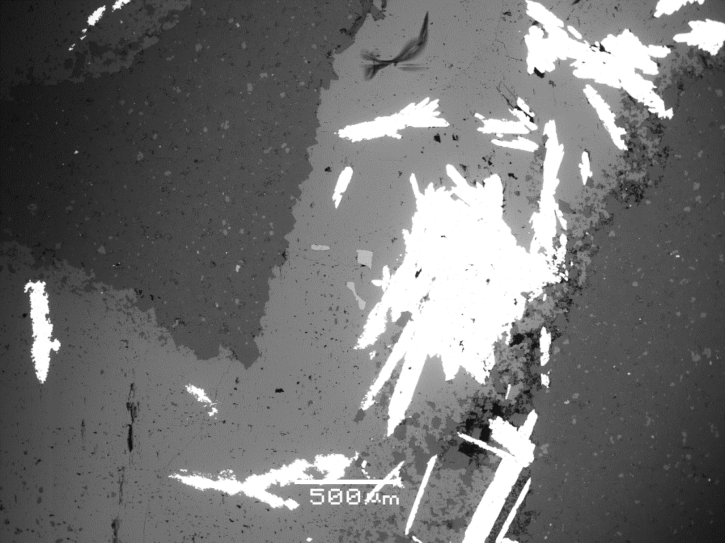
Backscattered electron image
FC78-7
Box 186-2
Slide FC07-15
504.4 – 507.2 m
Observed mineral assemblage:
-calcite
-dolomite
-quartz
-fluorite
-barite
-iron sulfide (pyrite/marcasite)
-potassium feldspar
-wollastonite
Dolomite lithic
Barite
Fluorite
Calcite
Notes:
I analyzed several thin section. The first step was to take photomicrographs using the petrographic microscope, which I did at USGS. Then I used the scanning electron microscope at NAU to image the thin sections and qualitatively identify minerals using the EDS – electron dispersive spectrometer.
This image shows minerals produced by hydrothermal alteration of the target parent rocks.
….fill in more later
(Wollastonite is pronounced wool-ass-ton-ite)
So what does this mean?!?
We know the input (original rock type) and we know the output (based on cores from Flynn creek)… Now we need to determine the temperatures at which these minerals crystallized.
Point out dolomitic lithic, a chunk of target rock.
The minerals found, including barite and fluorite are very helpful. These minerals are not found in the target rock, which suggests there was indeed a hydrothermal system.

Slide 8
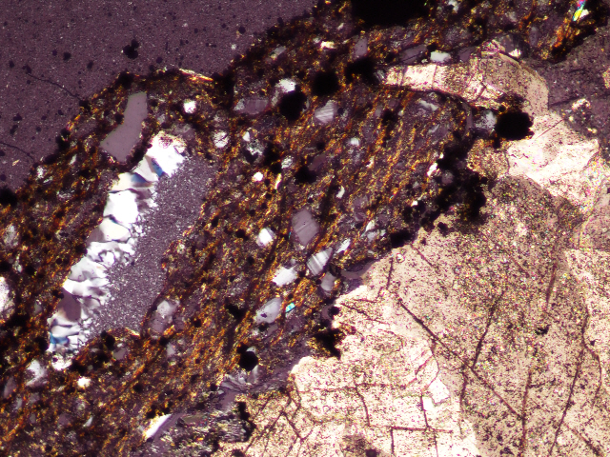
FC78-7
Box 199
FC07-13
541.6 - 544.7 m
Backscattered electron image
Dolomite/calcite lithic
pyrite
100 μm
Cross-polarized light micrograph
K-spar
SiO₂ lithic
SiO₂
Notes:
Explain cross polarized light and why we use it
More textures and minerals….

Slide 9
Kärdla and Haughton: marine target craters
Versh et al. (2005)
Osinski et al. (2013)
Notes:
These terrestrial impact craters also have hydrothermal systems
As a first approximation for the temperature range, I compared the FC mineral assemblage to theirs

Slide 10
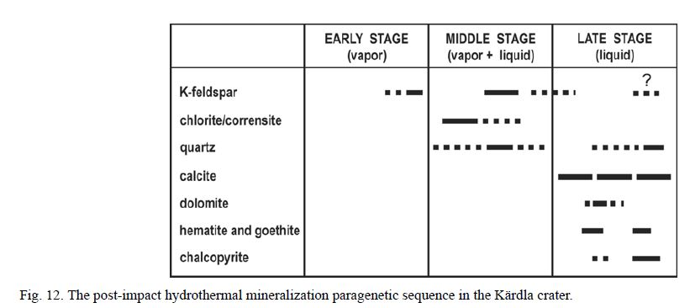
Discussion
Mineral assemblage
  Defines temperature range of hydrothermal system
Kärdla crater
4-km diameter crater, central uplift
>300 C
300 – 150/100 C
<100 C
Versh et al (2005)
Notes:
Say something about astrobiological implications

Slide 11
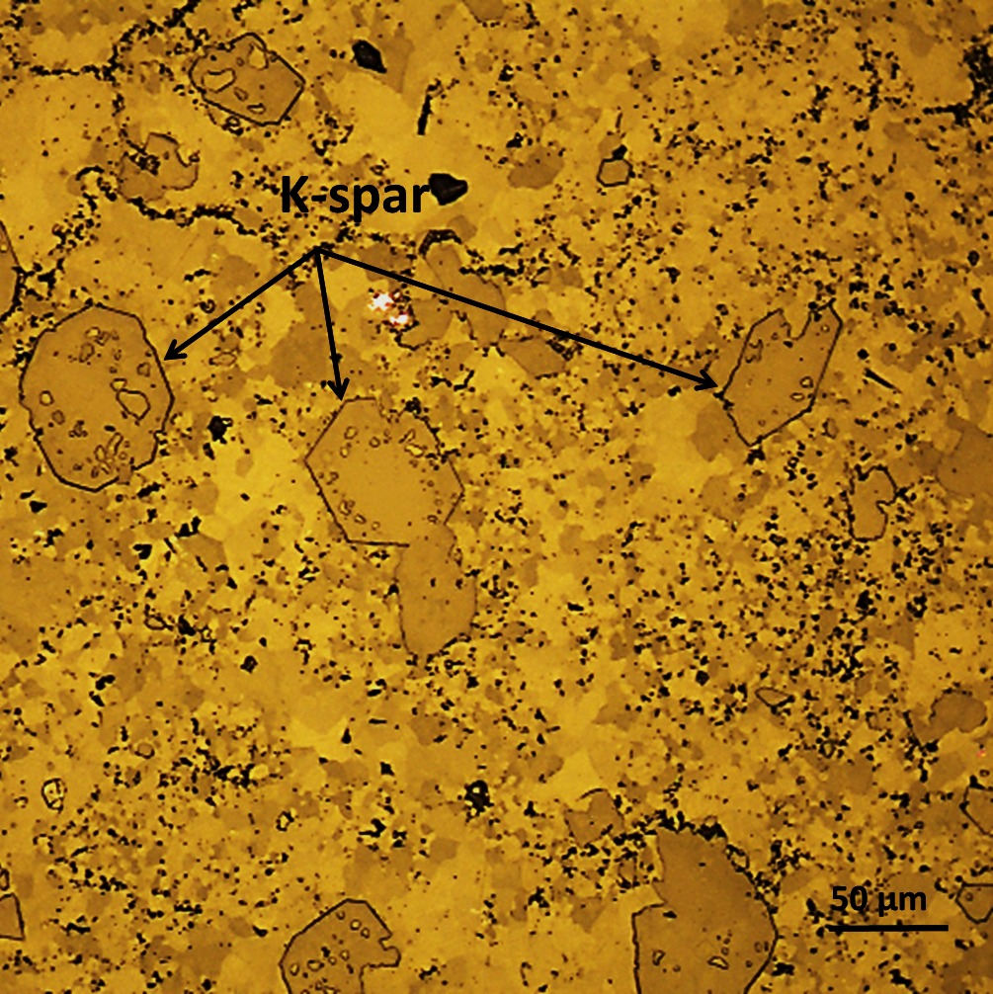
Future work
Reflected Light Micrograph
Continue characterization of cores
Bulk rock trace element analyses, isotopic studies, fluid inclusion analyses
Comparison to other impact craters, such as Kärdla crater

Slide 12
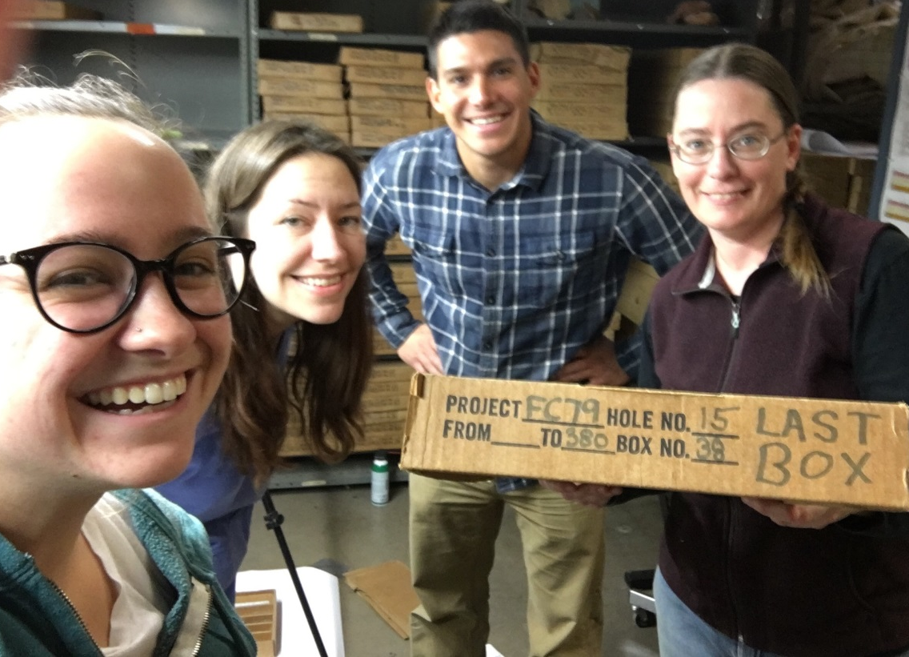


Acknowledgements
NASA Space Grant Consortium
Tenielle Gaither
Justin Hagerty
Amber Gullikson
Kyle Villarreal
Nadine Barlow
Kathleen Stigmon

Slide 13
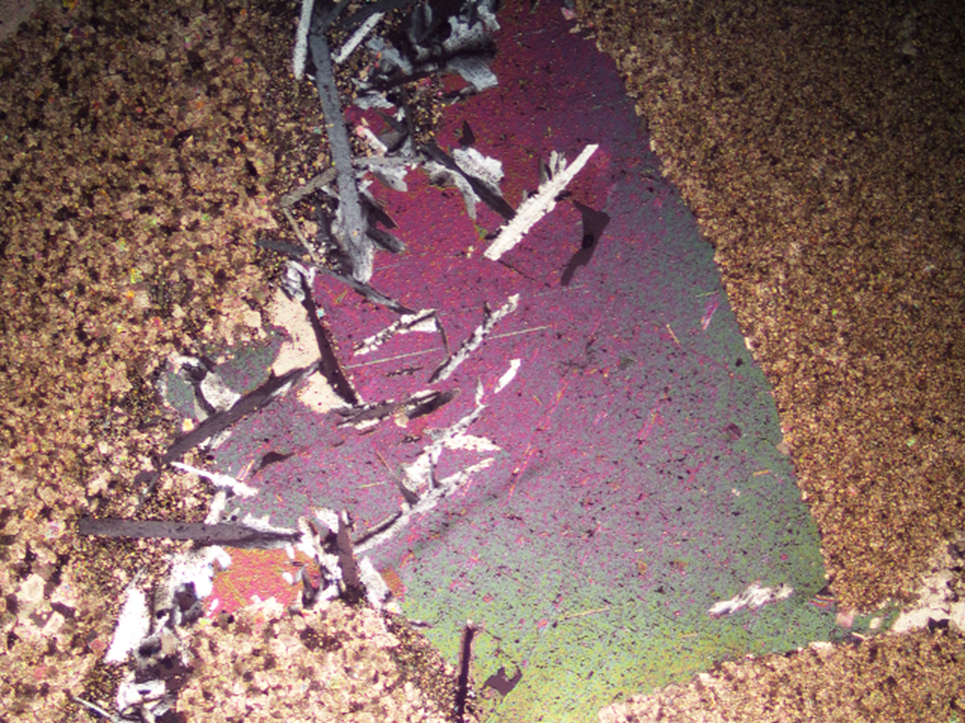
Questions?

